Slide 1



LIBRARY MANAGEMENT SYSTEM
Java FullStack Project
PROJECT STUDENT
O.MOHANA
43130763

Slide 2

AGENDA
Introduction
Existing Methods
Proposed Systems
Advantages
Disadvantages
Software Requirements
Modules
Modules Description
Conclusion
01

Slide 3
INTRODUCTION
The Library Management System is a web-based application designed to automate the daily activities of a library. It helps in managing books, users, and transactions in an organized manner .The system replaces traditional manual record keeping with a digital platform .It allows librarians to issue, return, and track books quickly and accurately .Students can easily search for available books and check their status online .The centralized database ensures secure and efficient data storage. It minimizes human errors and saves valuable time for both staff and users. Overall, it improves the accessibility, efficiency, and management of library resources.
02

Slide 4
EXISTING METHODS
Manual record keeping using registers or Excel sheets.
Time-consuming book issue and return process.
High chances of human error in data entry.
Difficult to track book availability.
No centralized database or backup.
Limited data security and accessibility.
03

Slide 5
PROPOSED SYSTEM
Automated and user-friendly library management software.
Centralized database for efficient data storage.
Role-based access for admin, librarian, and users.
Quick book search and availability status.
Easy issue and return management.
Report generation for better decision-making.
04

Slide 6

ADVANTAGES
The system saves a significant amount of time by automating manual and repetitive tasks.
It improves the accuracy of records and reduces the chances of human errors.
The data is stored securely in a centralized database, ensuring easy retrieval and backup.
It provides real-time information on book availability and user transactions.
The digital system promotes a paperless environment, supporting eco-friendly practices.
It offers an interactive and user-friendly interface that enhances the experience for both librarians and students.
05

Slide 7
DISADVANTAGES
The system requires a stable internet connection for proper online functioning.
The initial setup process and training for staff may take some time and effort.
Regular system maintenance and software updates are necessary to prevent errors.
There is a possibility of data loss if backups are not performed regularly.
If not properly secured, the system may face cybersecurity threats or unauthorized access.
Technical issues or system failures could temporarily interrupt the library’s operations.
05

Slide 8
SOFTWARE REQUIREMENTS
Tech Stack Frontend ReactJS (with Vite)
Axios for API communication
Modern CSS for styling
Backend
Java 17
Spring Boot 3.2.0
Spring Data JPA
Lombok
Database
PostgreSQL
06

Slide 9
MODULES
Admin Module
Librarian Module
User (Student) Module
Book Management Module
Issue/Return Module
Report Generation Module
Notification Module
Authentication & Security Module
Feedback & Help Module
07

Slide 10
MODULE DESCRIPTION
Admin Module: Manages users, roles, permissions, and overall system settings.
Librarian Module: Handles book cataloging, issuing, and returning activities.
User Module: Allows students or users to search, view, and reserve books online.
Book Management Module: Responsible for adding, updating, and deleting book records.
Issue/Return Module: Maintains detailed records of issued and returned books.
Report Generation Module: Generates analytical reports about book usage, late returns, and activity logs.
07

Slide 11
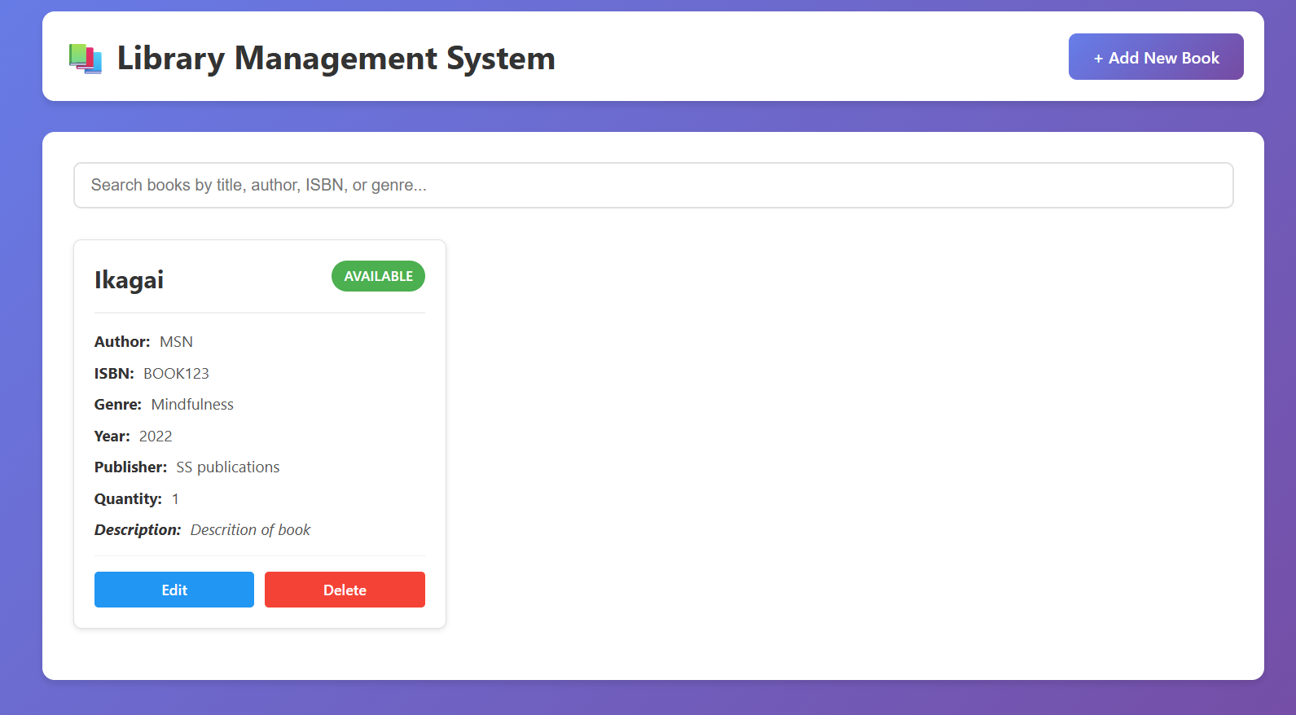
SAMPLE OUTPUT
08

Slide 12
CONCLUSION
The system efficiently automates all manual library processes. It ensures accurate, secure, and up-to-date management of data.
Reduces the workload for librarians and improves service speed.
Students can easily access and manage their book information online.
Real-time updates help track resources and maintain order.
Enhances transparency and user satisfaction.
Saves time and minimizes paperwork in daily operations.
Overall, it makes the library more efficient, organized, and modern.
09

Slide 13
THANK YOU
10

